Slide 1

Whole Note
=
4 beats

Slide 2
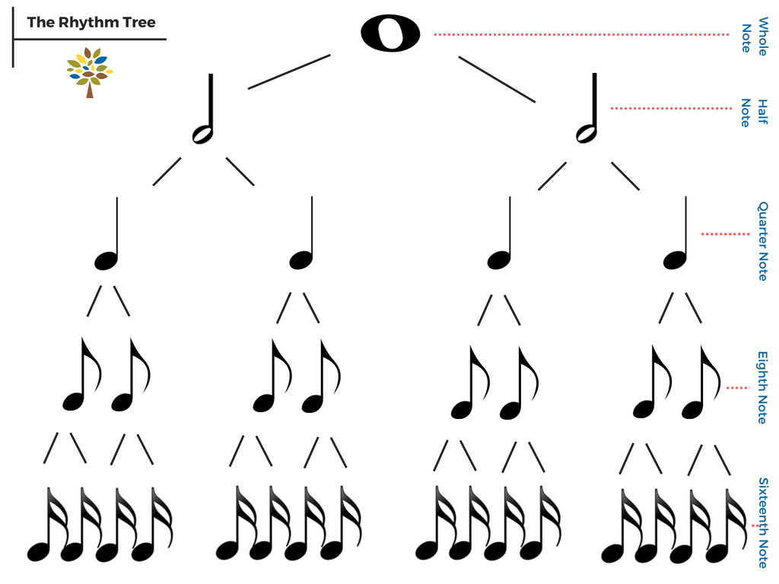
4

Slide 3
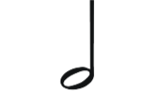
Half Note
=
2 beats

Slide 4
4
2
2

Slide 5

Quarter Note
=
1 Beat

Slide 6
4
2
2
1
1
1
1

Slide 7

1/2 Beat
=
Eighth Note

Slide 8
4
2
2
1
1
1
1
1/2
1/2
1/2
1/2
1/2
1/2
1/2
1/2

Slide 9

Here is what happens when some eighth notes get too close to each other.
1/2
1/2
= 1

Slide 10

Whole Note Slide

Slide 11
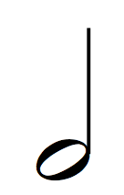
Half Note Fancy Bow

Slide 12

Quarter Note Jumping

Slide 13

Eighth Note Jumping Jacks! Eighth Note Jumping Jacks!

Slide 14
Half Note Fancy Bow

Slide 15
Quarter Note Jumping

Slide 16
Eighth Note Jumping Jacks! Eighth Note Jumping Jacks!

Slide 17
Whole Note Slide

Slide 18
Eighth Note Jumping Jacks! Eighth Note Jumping Jacks!

Slide 19
Half Note Fancy Bow

Slide 20
Quarter Note Jumping

Slide 21
Let’s make it a little harder!

